Slide 1
Basics of Computer Network

Slide 2
Introduction
Physical devices that allow hardware on a computer network to interact and communicate with one another.
Examples:
Repeater, Hub, Bridge, Switch, Routers, Gateway, Brouter, and NIC, etc.

Slide 3
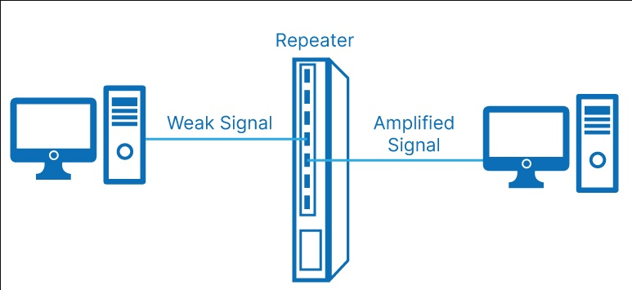
Repeater
A repeater is a network device used to regenerate or replicate a signal
Operates at the physical layer (Layer 1) of the OSI model, used to extend the transmission distance by amplifying the signal
Use Case: Extending the range of a network segment beyond its inherent limit.

Slide 4
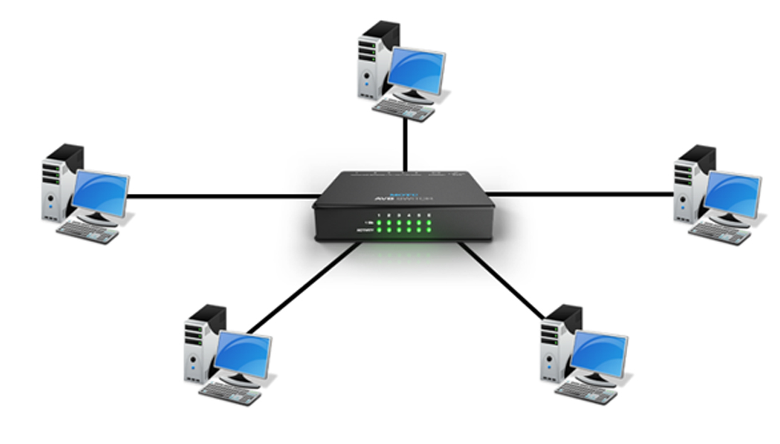
HUB
A hub is a basic networking device that connects multiple Ethernet devices, making them act as a single network segment
Operates at the physical layer (Layer 1) of the OSI model, simply forwards data packets to all devices in the network
Suitable for small, simple local area networks (LANs).

Slide 5
Types of Hub
Active Hub: These are the hubs that have their power supply and can clean, boost, and relay the signal along with the network. It serves both as a repeater as well as a wiring center. These are used to extend the maximum distance between nodes.
Passive Hub: These are the hubs that collect wiring from nodes and power supply from the active hub. These hubs relay signals onto the network without cleaning and boosting them and can’t be used to extend the distance between nodes.
Intelligent Hub: It works like an active hub and includes remote management capabilities. They also provide flexible data rates to network devices. It also enables an administrator to monitor the traffic passing through the hub and to configure each port in the hub.

Slide 6
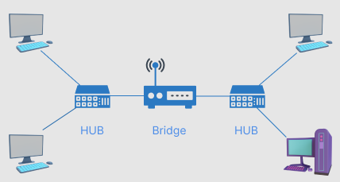
Bridge
A bridge is a network device that connects and filters traffic between two network segments
Operates at the data link layer (Layer 2) of the OSI model, used to divide larger networks into smaller segments
Reducing network traffic, improving security, and managing bandwidth.

Slide 7
Types of Bridges
Transparent Bridges: These are the bridge in which the stations are completely unaware of the bridge’s existence i.e. whether or not a bridge is added or deleted from the network, reconfiguration of the stations is unnecessary. These bridges make use of two processes i.e. bridge forwarding and bridge learning.
Source Routing Bridges:- In these bridges, routing operation is performed by the source station and the frame specifies which route to follow. The host can discover the frame by sending a special frame called the discovery frame, which spreads through the entire network using all possible paths to the destination.

Slide 8
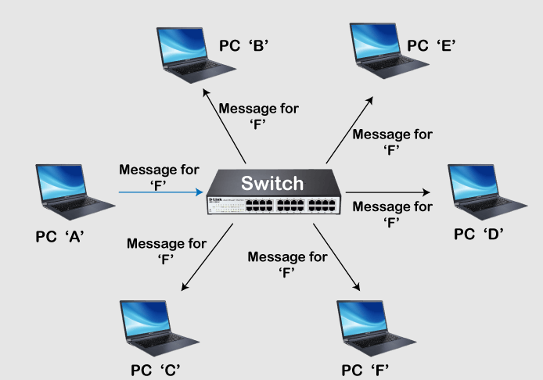
Switch
A switch is a network device that connects devices within a network and uses MAC addresses to forward data to the correct destination
Operates at the data link layer (Layer 2) and sometimes the network layer (Layer 3) of the OSI model, creates a separate collision domain for each connected device
Common in modern LANs to enhance performance and manageability.

Slide 9
Types of Switch
Unmanaged Switch
Managed Switch
Smart Switch
Layer 2 Switch
Layer 3 Switch
PoE Switch
Gigabit Switch
Rach-mounted Switch
Desktop Switch
Modular Switch

Slide 10
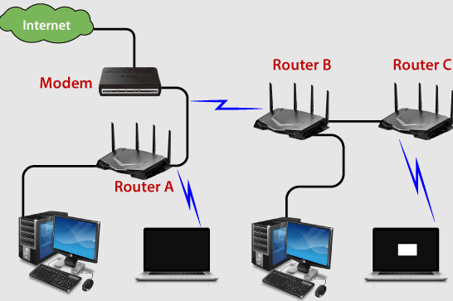
Router
A router is a device that forwards data packets between computer networks, directing the data along the most efficient route.
Operates at the network layer (Layer 3) of the OSI model, connects different networks and manages traffic between them.
Essential for internet connectivity, connecting home and business networks to the internet.

Slide 11
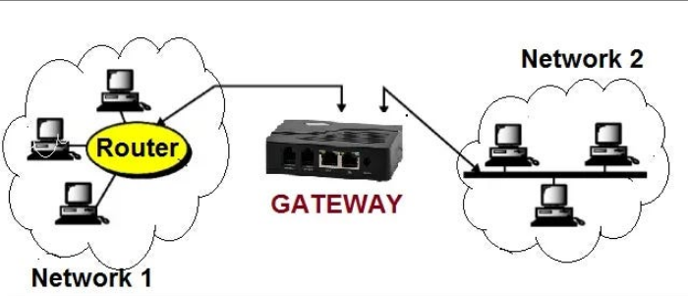
Gateway
A gateway is a network device that acts as a "gate" between two networks, often different in protocols.
Operates at multiple layers of the OSI model, used to translate and route traffic between different networks or systems.
Connecting different network architectures, such as an internal company network to the internet.

Slide 12
Brouter
A brouter (bridge router) is a hybrid device that combines the features of both a bridge and a router.
Can operate at both the data link layer (Layer 2) and the network layer (Layer 3) of the OSI model, routes traffic for known protocols and bridges traffic for unknown protocols.
Versatile device for complex networking environments.

Slide 13
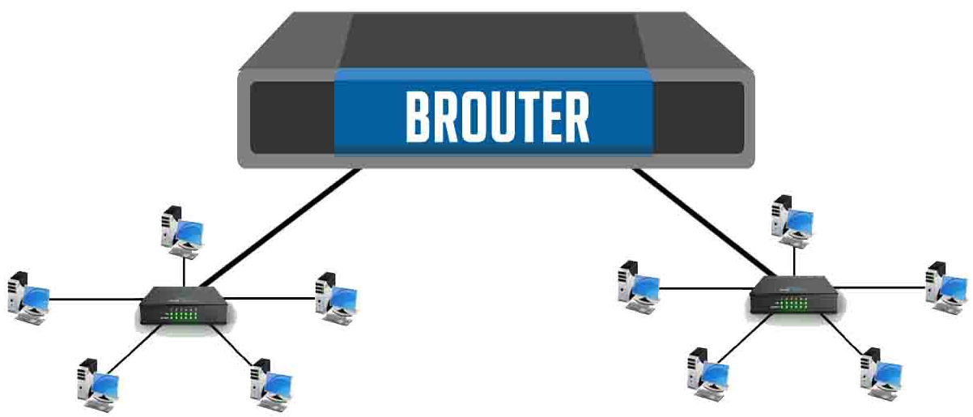

Slide 14
IP (Internet Protocol)Address
An IP address is a unique identifier assigned to each device connected to a network that uses the Internet Protocol for communication.
Types: IPv4 (e.g., 192.168.1.1)
IPv6 (e.g., 2001:0db8:85a3:0000:0000:8a2e:0370:7334).
Function: Identifies the host and provides the location in the network.

Slide 15
IPv4
IPv4 addresses are 32-bit integers that have to be expressed in Decimal Notation.
It is represented by 4 numbers separated by dots in the range of 0-255, which have to be converted to 0 and 1, to be understood by Computers.
Example: An IPv4 Address can be written as 192.168.1.10.

Slide 16
IPv6
IPv6 is written as a group of 8 hexadecimal numbers separated by colon (:)
It can be written as 128 bits of 0s and 1s.

Slide 17
IPv4 vs Ipv6
IPv4 | IPv6
IPv4 has a 32-bit address length | IPv6 has a 128-bit address length
It Supports Manual and DHCP address configuration | It supports Auto and renumbering address configuration
In IPv4 end to end, connection integrity is Unachievable | In IPv6 end-to-end, connection integrity is Achievable
It can generate 4.29×10⁹ address space | The address space of IPv6 is quite large it can produce 3.4×10³⁸ address space
The Security feature is dependent on the application | IPSEC is an inbuilt security feature in the IPv6 protocol
Address representation of IPv4 is in decimal | Address Representation of IPv6 is in hexadecimal
Fragmentation performed by Sender and forwarding routers | In IPv6 fragmentation is performed only by the sender
In IPv4 Packet flow identification is not available | In IPv6 packet flow identification are Available and uses the flow label field in the header
In IPv4 checksum field is available | In IPv6 checksum field is not available
It has a broadcast Message Transmission Scheme | In IPv6 multicast and anycast message transmission scheme is available
In IPv4 Encryption and Authentication facility not provided | In IPv6 Encryption and Authentication are provided
IPv4 has a header of 20-60 bytes. | IPv6 has a header of 40 bytes fixed
IPv4 can be converted to IPv6 | Not all IPv6 can be converted to IPv4
IPv4 consists of 4 fields which are separated by addresses dot (.) | IPv6 consists of 8 fields, which are separated by a colon (:)
IPv4’s IP addresses are divided into five different classes. Class A , Class B, Class C, Class D , Class E. | IPv6 does not have any classes of the IP address.
IPv4 supports VLSM(Variable Length subnet mask). | IPv6 does not support VLSM.
Example of IPv4: 66.94.29.13 | Example of IPv6: 2001:0000:3238:DFE1:0063:0000:0000:FEFB

Slide 18
MAC Address
A MAC (Media Access Control) address is a unique identifier assigned to a network interface controller (NIC) for use as a network address in communications within a network segment.
A 12-digit hexadecimal number assigned to each device connected to the network. (Works with DLL)
Typically represented as a series of hexadecimal digits (e.g., ZZ:1A:2B:3C:4D:5E).
Used for communication within the physical network segment.

Slide 19
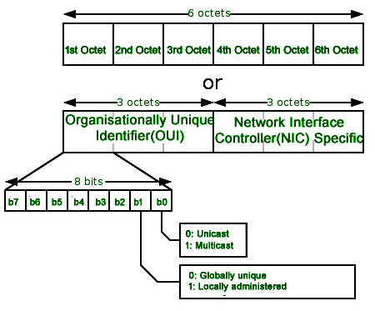

Slide 20
Format of MAC Address
The First 6 digits (say 00:40:96) of the MAC Address identify the manufacturer, called the OUI (Organizational Unique Identifier).
CC:46:D6 - Cisco
3C:5A:B4 - Google, Inc.
3C:D9:2B - Hewlett Packard
00:9A:CD - HUAWEI TECHNOLOGIES CO.,LTD
The rightmost six digits represent Network Interface Controller, which is assigned by the manufacturer.

Slide 21
Port
A port is a logical access channel for communication between devices over a network.
Types: Well-known ports (0-1023), Registered ports (1024-49151), Dynamic or Private ports (49152-65535).
Function: Identifies specific processes or services on a device.

Slide 22
Types of Port
Well Known Port
It is from the range 0 to 1023
It is reserved for common and specifically used service
It is used by some widely adopted protocols and services like HTTP(port 80), FTP(port 21), DNS(Port 53), SSH(port 22), etc

Slide 23
2. Registered Port
It is from range 1024 to 49151
These are used by applications or services that are not as common
But it is used by those applications or services which require its specific port
Organizations can ask IANA(Internet Assigned Number Authority) for any specific port number within this range

Slide 24
3. Dynamic Port
It is from range 49152 to 65535
It is also known as Ephemeral or Private Port
It is used for those connections that are temporary or short-lived
It is not registered or assigned and can be used by any process

Slide 25
Commonly Used Ports
Port Number | Used By
80 | HTTP(Hyper Text Transfer Protocol)
23 | Telnet
25 | SMTP(Simple Mail Transfer Protocol)
53 | DNS(Domain Name System)
7 | Echo
20/21 | FTP(File Transfer Protocol)
69 | TFTP(Trivial File Transfer Protocol)
443 | HTTPS(Hyper Text Transfer Protocol Secure)
22 | SSH(Secure Shell)

Slide 26
Socket
A socket is an endpoint for sending or receiving data across a computer network.
Components: Consists of an IP address and a port number (e.g., 192.168.1.1:80).
Function: Facilitates communication between two nodes on a network.

Slide 27
Types of Socket
1. Datagram Socket
This is a type of network which has connection less point for sending and receiving packets.
It is similar to mailbox.
The letters (data) posted into the box are collected and delivered (transmitted) to a letterbox (receiving socket).

Slide 28
2. Stream Socket
A type of interprocess communications socket or network socket which provides a connection-oriented, sequenced, and unique flow of data without record boundaries with well defined mechanisms for creating and destroying connections and for detecting errors.
It is similar to phone.
A connection is established between the phones (two ends) and a conversation (transfer of data) takes place.

Slide 29
Examples of Function Call
Function Call | Description
Socket() | To create a socket
Bind() | It’s a socket identification like a telephone number to contact
Listen() | Ready to receive a connection
Connect() | Ready to act as a sender
Accept() | Confirmation, it is like accepting to receive a call from a sender
Write() | To send data
Read() | To receive data
Close() | To close a connection

Slide 30
DNS
A DNS (Domain Name System) server translates human-readable domain names (e.g., www.example.com) into IP addresses.
Function: Resolves domain names to their corresponding IP addresses.
Example: When a user types a URL into a browser, the DNS server translates it to an IP address so the browser can load the correct website.

Slide 31
Types of Domains
Generic Domain: .com, .org, .mil, .net
Country domain: .com.np, .gov.np, .gov
Inverse domain: Ip to domain mapping

Slide 32
ARP (Address Resolution Protocol)
ARP is a protocol used for mapping an IP address to a MAC address within a local network.
Function: Resolves the MAC address of the device associated with a given IP address.
Process: Sends an ARP request to all devices on the network and the device with the matching IP address replies with its MAC address.

Slide 33
RARP (Reverse Address Resolution Protocol)
A network protocol used by a computer to request its IP address from a gateway server's Address Resolution Protocol (ARP) table or cache.
It is primarily used by diskless workstations or devices that do not know their own IP address when they boot up.
Function: map a known MAC (Media Access Control) address to an IP (Internet Protocol) address..
Process: Request and Response Phase

Slide 34
Request Phase:
When a device starts up, it broadcasts a RARP request packet on the network.
The request contains the device's own MAC address, asking for the corresponding IP address.
Response Phase:
A RARP server on the network (usually configured in the router or another dedicated server) listens for RARP requests.
Upon receiving a RARP request, the server looks up the MAC address in a table that maps MAC addresses to IP addresses.
If a match is found, the server sends a RARP response packet back to the requesting device, containing the assigned IP address.

Slide 35
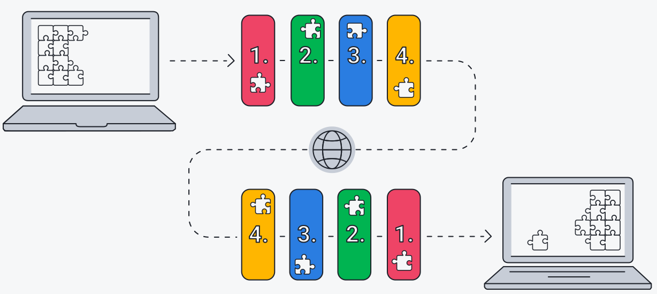
TCP/IP Model
Four Layers

Slide 36
Layers in TCP/IP Model
Network Access Layer
Internet/ Network Layer
Transport Layer
Application Layer

Slide 37
1. Network Access Layer
Responsible for the physical transmission of data over the network.
Function: Handles the hardware addressing and the physical medium used for communication.
Protocols: Ethernet, Wi-Fi, Token Ring, ARP, RARP.Devices: Network Interface Cards (NICs), switches, routers.

Slide 38
2. Network/Internet Layer
Handles logical addressing and routing of data packets.
Function: Ensures that data packets are sent across networks.
Protocols: IP (Internet Protocol), ICMP (Internet Control Message Protocol), IGMP (Internet Group Management Protocol).Devices: Routers, Layer 3 switches.

Slide 39
3. Transport Layer
Manages end-to-end communication, error checking, and data flow control.
Function: Ensures reliable data transfer and proper sequencing.
Protocols: TCP (Transmission Control Protocol), UDP (User Datagram Protocol).Services: Connection-oriented communication (TCP), connectionless communication (UDP).

Slide 40
4. Application layer
Provides network services to applications and end-users.
Function: Facilitates communication between software applications and the network.
Protocols: HTTP, FTP, SMTP, DNS, Telnet, SSH.Services: Web browsing, file transfer, email, domain name resolution, remote login.

Slide 41
In Short:
Network Interface Layer: Ensures physical connectivity and hardware addressing.
Internet Layer: Manages logical addressing and routing.
Transport Layer: Ensures reliable data transmission.
Application Layer: Provides services directly to user applications.

Slide 42
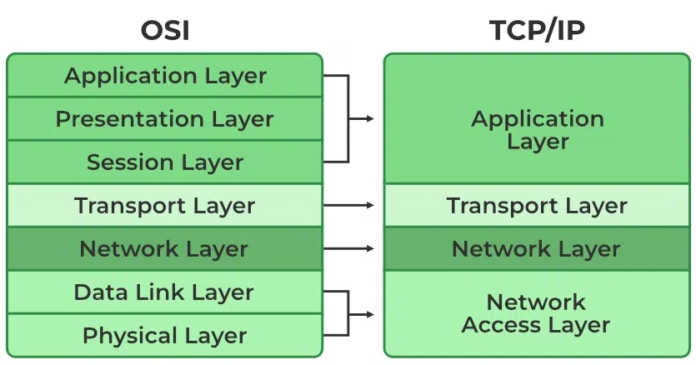
OSI vs TCP/IP Model

